Slide 1

MEETING ETIQUETTE
MANU S MOHAN
SREEHARI JEEVAN

Slide 2

Understanding Business meeting Etiquette
Help you look confident, capable, and promotable
Silence your phone and close your laptop
Sit straight, be attentive, and smile.
Dress well
Be on time

Slide 3
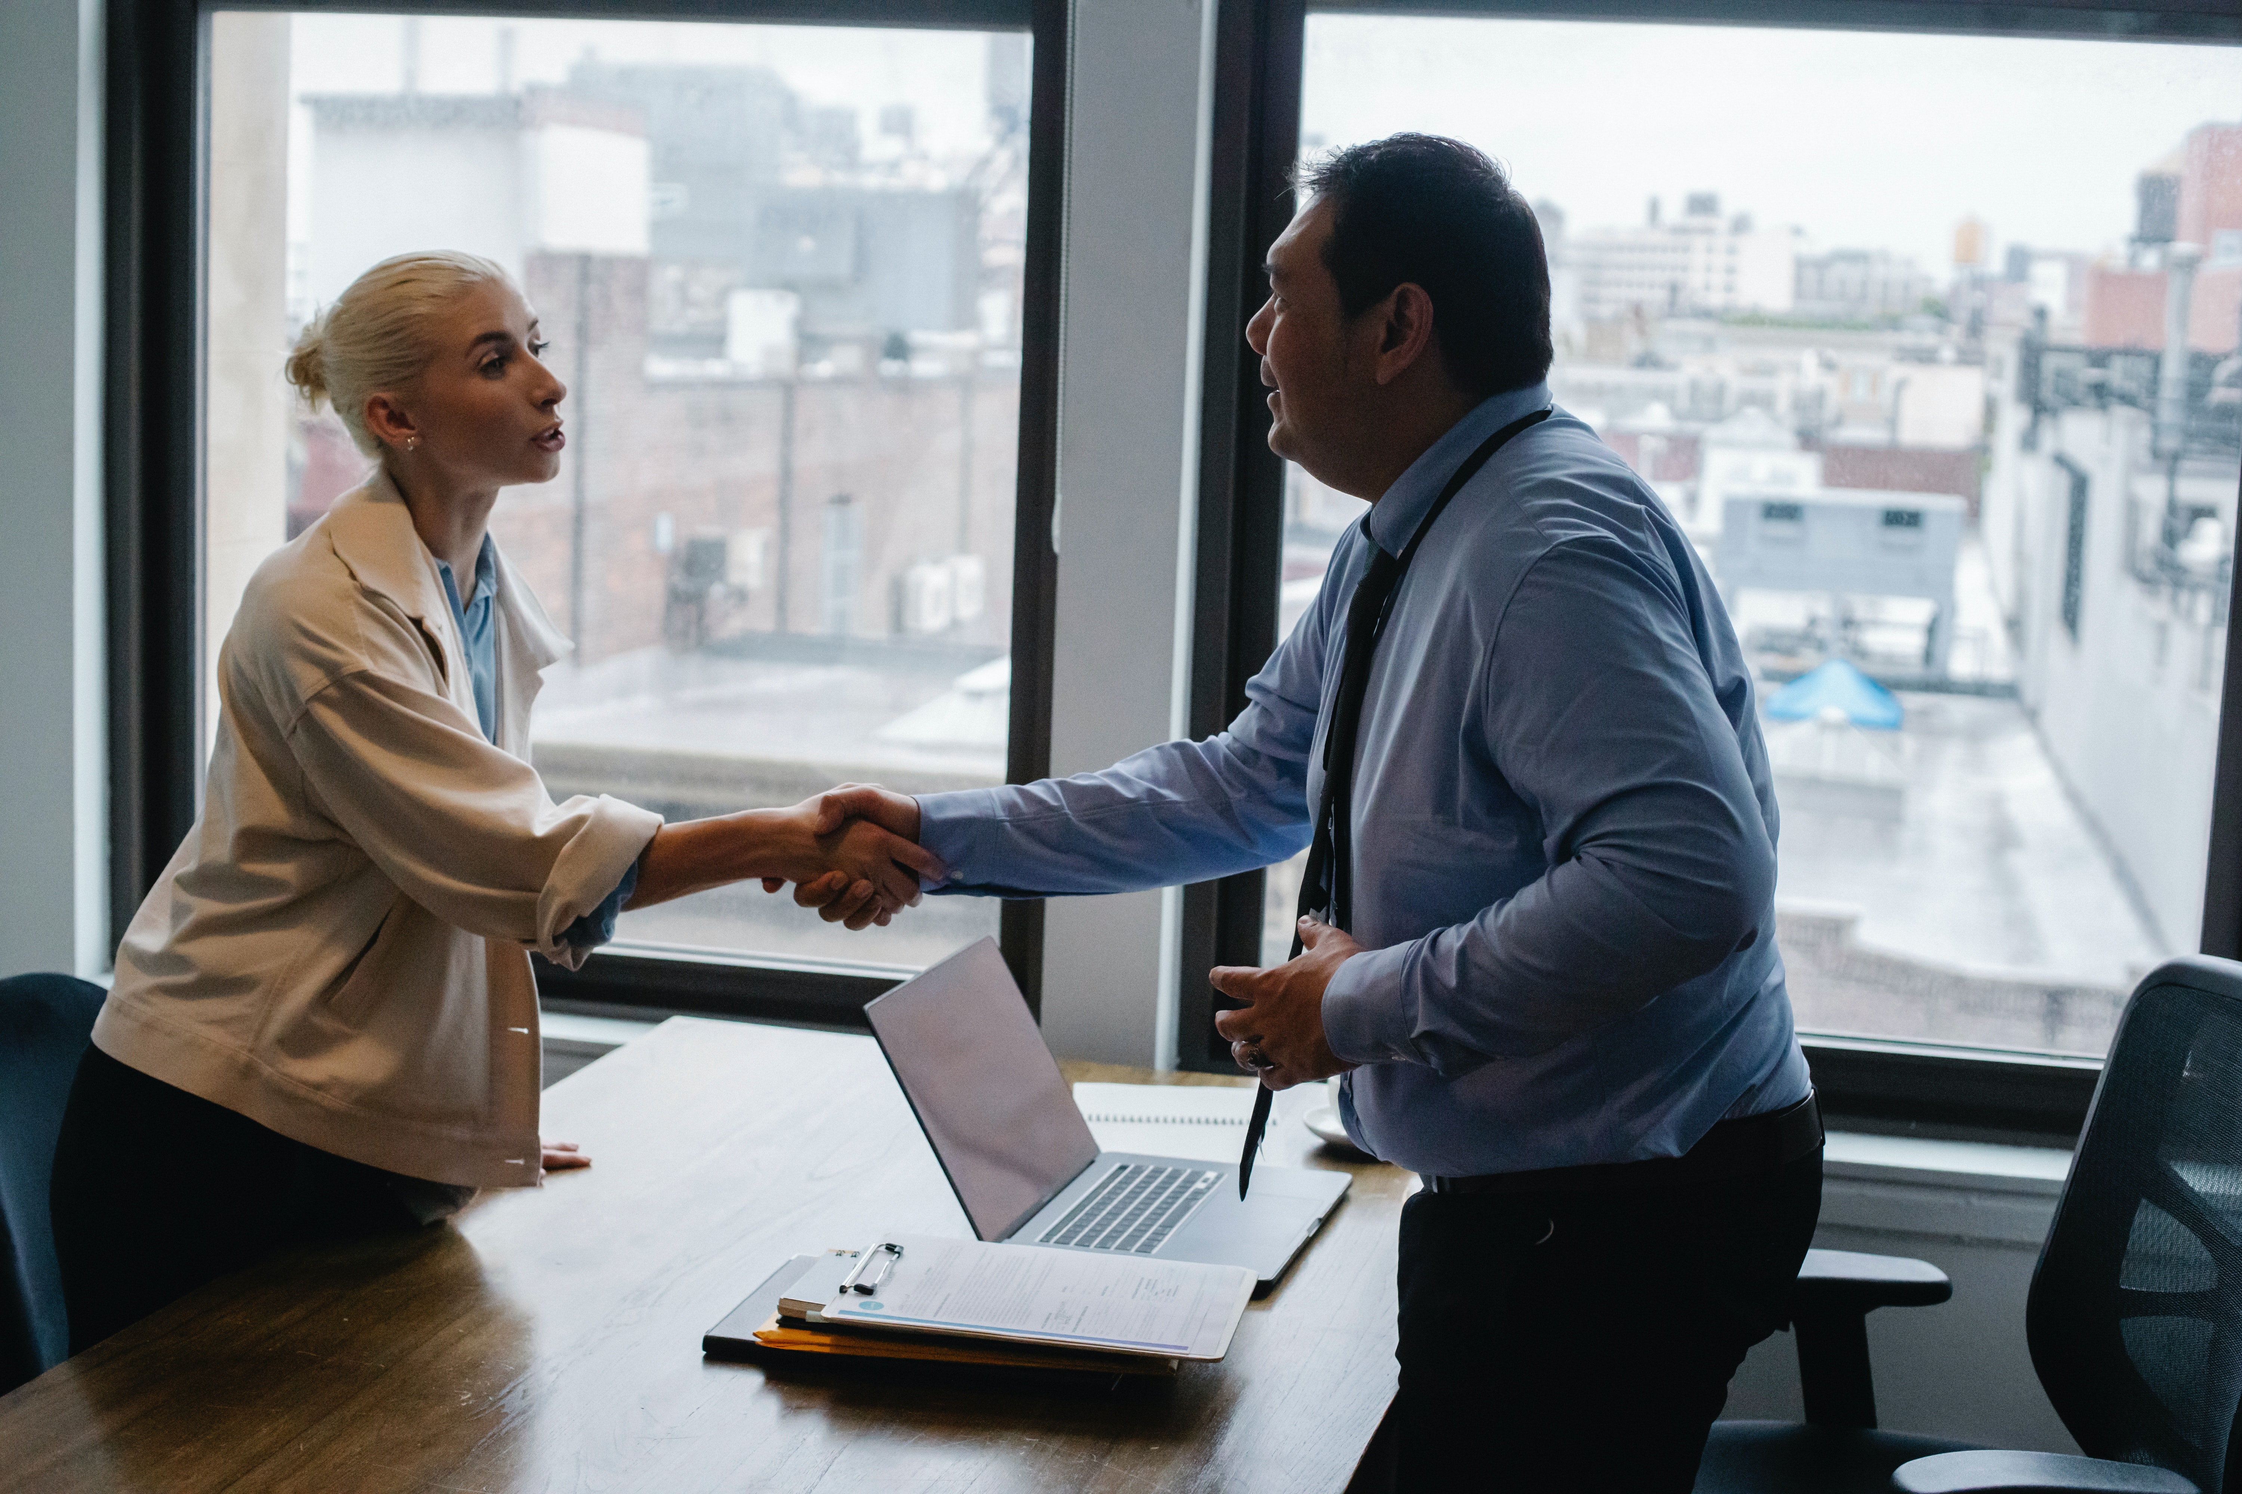
Understanding Business meeting Etiquette
Be prepared
Introduce yourself
Don't interrupt when someone's speaking
Avoid eating during the meeting
Push in your chair and pick up after yourself.

Slide 4

Presenting Ideas And Handling Conflict In Meetings
Sit at the middle of the table
Speak up early.
Don't hesitate, be confident
Prepare ahead of time

Slide 5

Presenting Ideas And Handling Conflict In Meetings
Don't be afraid to disagree
The more you practice this, the easier and better you'll get at it

Slide 6
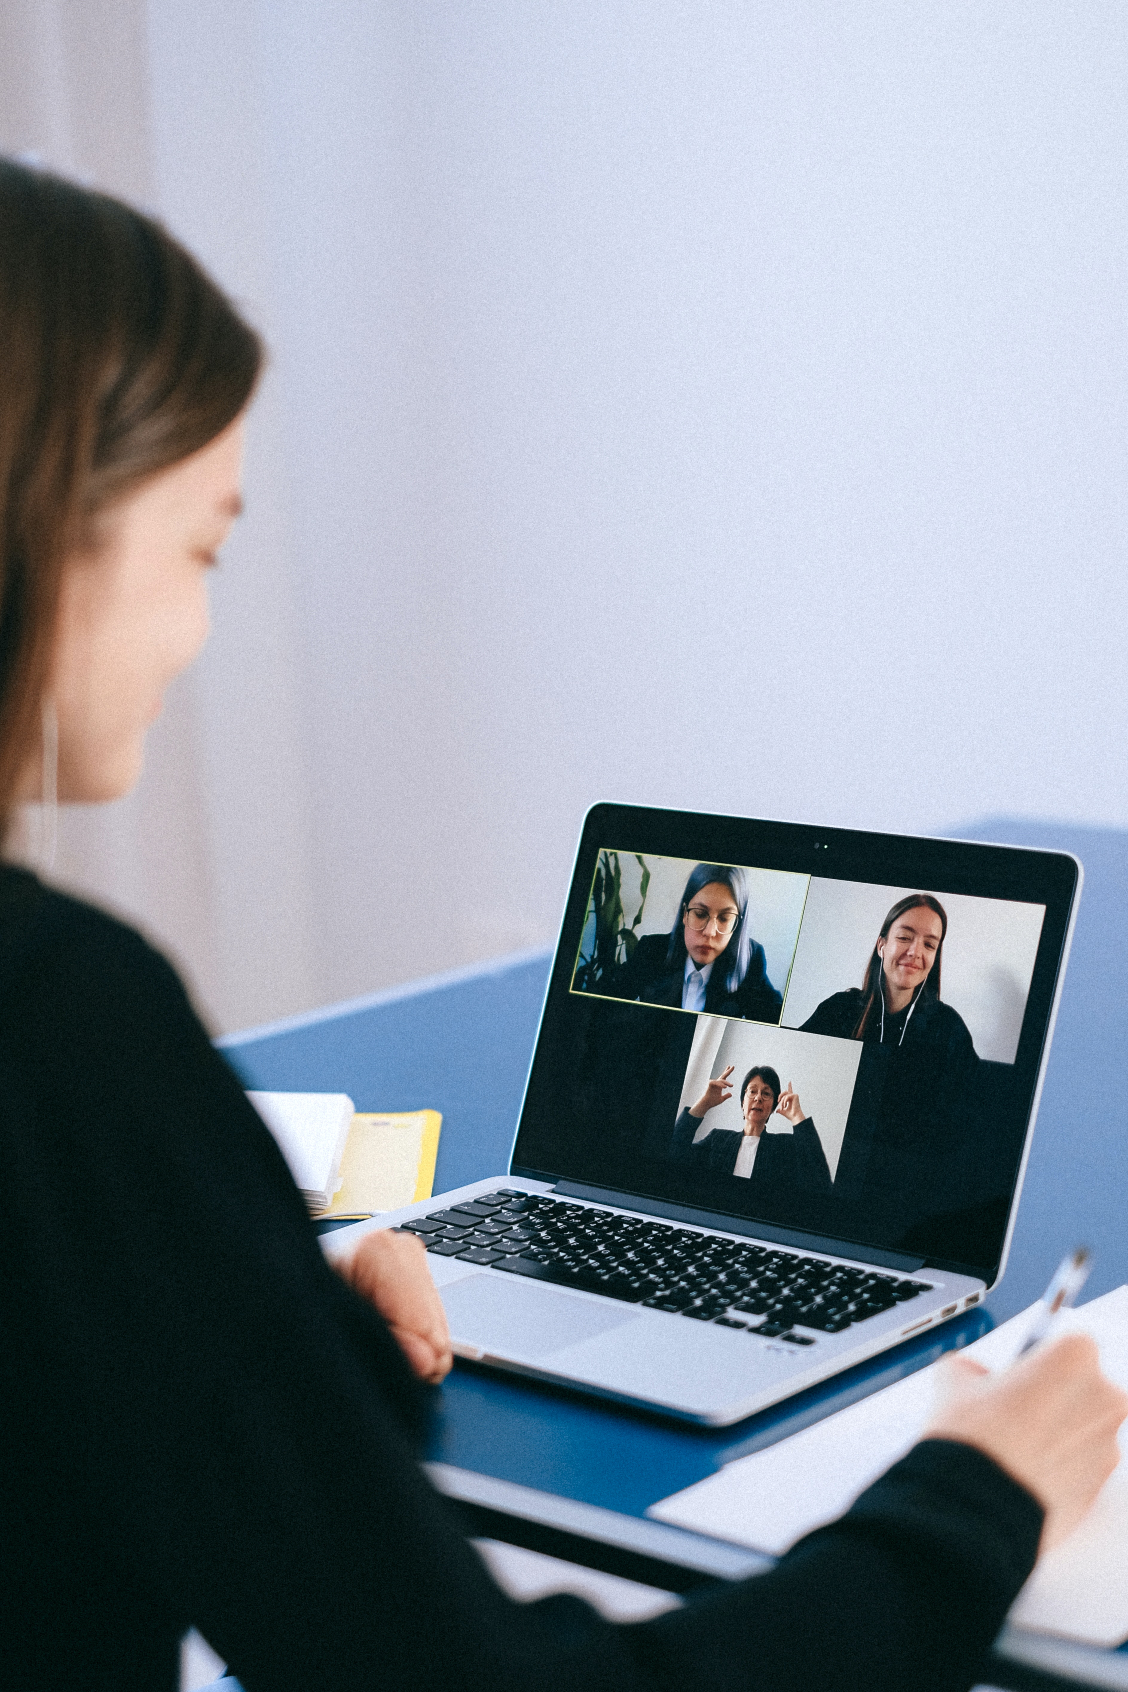
Etiquette For Video Meetings
Turn your phone to silent
Sit up straight, smile
Minimize outside noise
Speak in a normal, confident tone

Slide 7
Etiquette For Video Meetings
Log in to the meeting at least 10 minutes early
Try not to interrupt other people
Try not to dominate the call
Make sure to say goodbye

Slide 8


THANK YOU

